Slide 1

Watumull Institute Of Electronics Engineering And Computer Technology
Secure File Storage Using Hybrid Cryptography
By Group 15
Siddharth Bhamare (06)
Pushpak Maind (28)
Rahul Patil (37)
Vishal Shirke (48)
Project Guide:
Prof. Ranjana Singh

Slide 2

INTRODUCTION
The Digital Revolution has brought with it an exponential growth in the usage of digital computation and along with it, the start of the Information Era. Furthermore, companies are expanding globally and opening offices at various locations across the globe.
Accessing data from any location.
Storage has security risks and data leak possibilities.
Data security is very important.
This Photo by Unknown Author is licensed under CC BY-NC-ND

Slide 3

SCOPE
In the world of data being the key asset, safeguarding our asset is primary responsibility. Communications, databases, infrastructure, transactions, knowledge; an organization’s data is arguably its most valuable asset. It is in a business’ best interests to keep its information safe, regardless of legal or regulatory requirements.
A system which stores data after encryption.
This prevents data leak if a breach occurred.
Any form of data can be stored.
It ensures data confidentiality to users.

Slide 4
PROPOSED SYSTEM
A secure file and password storage using cryptography.
A proper registration/login based system for using the website.
The system will help user to secure data using different encryption algorithm .
User can upload passwords as well as text files.
The user with the proper key will be able to access the particular file.
The primary goal of the system is to provide and simulate an solution to face the challenges and solve security issues that exists in cloud computing.

Slide 5
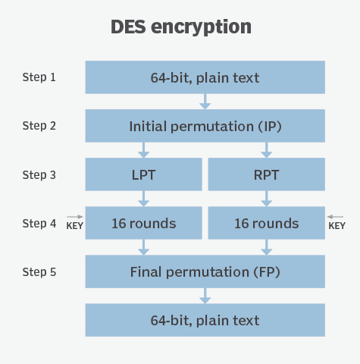
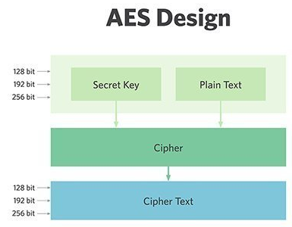
Algorithm
DES :
Data Encryption Standard (DES) is a symmetric-key block cipher.
Encrypts data in blocks of size of 64 bits each and Key length is 56 bits.
DES is based on the two attributes: substitution and transposition.
DES consists of 16 rounds. The result of this process produces 64-bit cipher text.
AES :
Advanced Encryption Standard (AES) is based on ‘substitution–permutation network’.
The key size can be 128/192/256 bits.
The number of rounds depends on the key length: 10/12/14 rounds.
Encrypts data in blocks of 128 bits each.

Slide 6
ALGORITHM
Blowfish Design
Blowfish:
Alternate to DES
Blowfish is a Block cipher
Characteristics Include:
Block size: 64-bits
Variable key size:32-bits to 448-bits
16 rounds of encryption
Cipher text: 16-bits
IDEA:
Block size: 16-bits
Key size: 32-bits
8 rounds of encryption
Cipher text: 16-bits
64-bit Plain Text
16 Round Encryption
64-bit Cipher Text
IDEA Design
16-bit Plain Text
8 Round Encryption
16-bit Cipher Text

Slide 7
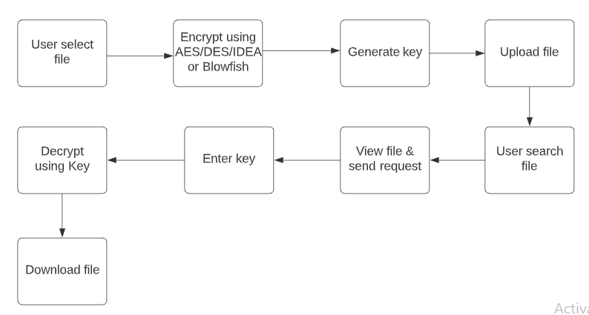
Project Workflow

Slide 8
Hardware Requirements:
Computer/laptop
Intel i3 6th Gen or higher/4gb Ram
Software Requirements:
Python
Flask
HTML
CSS
JavaScript
SQL

Slide 9
References
Ruchita Sharma, Swarnalata Bollavarapu(2015).Data Security using Compression and Cryptography Techniques. 2015International Journal of Computer Applications.
Mahavir Jain,Arpit Agrawal(2014).Implementation Of Hybrid Cryptography Algorithm. International Journal Of Core Engineering & Management(IJCEM).
Kumar, A., Lee, B. G., Lee, H., & Kumari, A. (2012). Secure storage and access of data in cloud computing. 2012 International Conference on ICT Convergence (ICTC).
William Stallings : “Cryptography and network security: Principles and Practices”.
Nick Hoffman “A Simplified IDEA Algorithm” Department of Mathematics, Northern Kentuckya University pp 1-5, 2007.
Meier, W., On the Security of the IDEA block cipher, Advances in Cryptology.
William Stallings : “Cryptography and network security: Principles and Practices”.

Slide 10
!!! Thank you !!!

